Slide 1

MET AD 599:
Python & SQL for Business Analytics
Oliver Hancock

Slide 2

Project Overview
Analyze an LMS database using SQL and Python.
Build a machine learning model to identify at-risk students.
Create visualizations to interpret performance and engagement trends.
Produce recommendations and a summary dashboard for academic insight.

Slide 3
What is the business domain?
LMS.db represents a university learning management system.
Includes students, instructors, courses, assignments, quizzes, and submissions.
Enables tracking of performance, engagement, and academic progress.
Supports analytics on trends, risk signals, and instructional effectiveness.

Slide 4
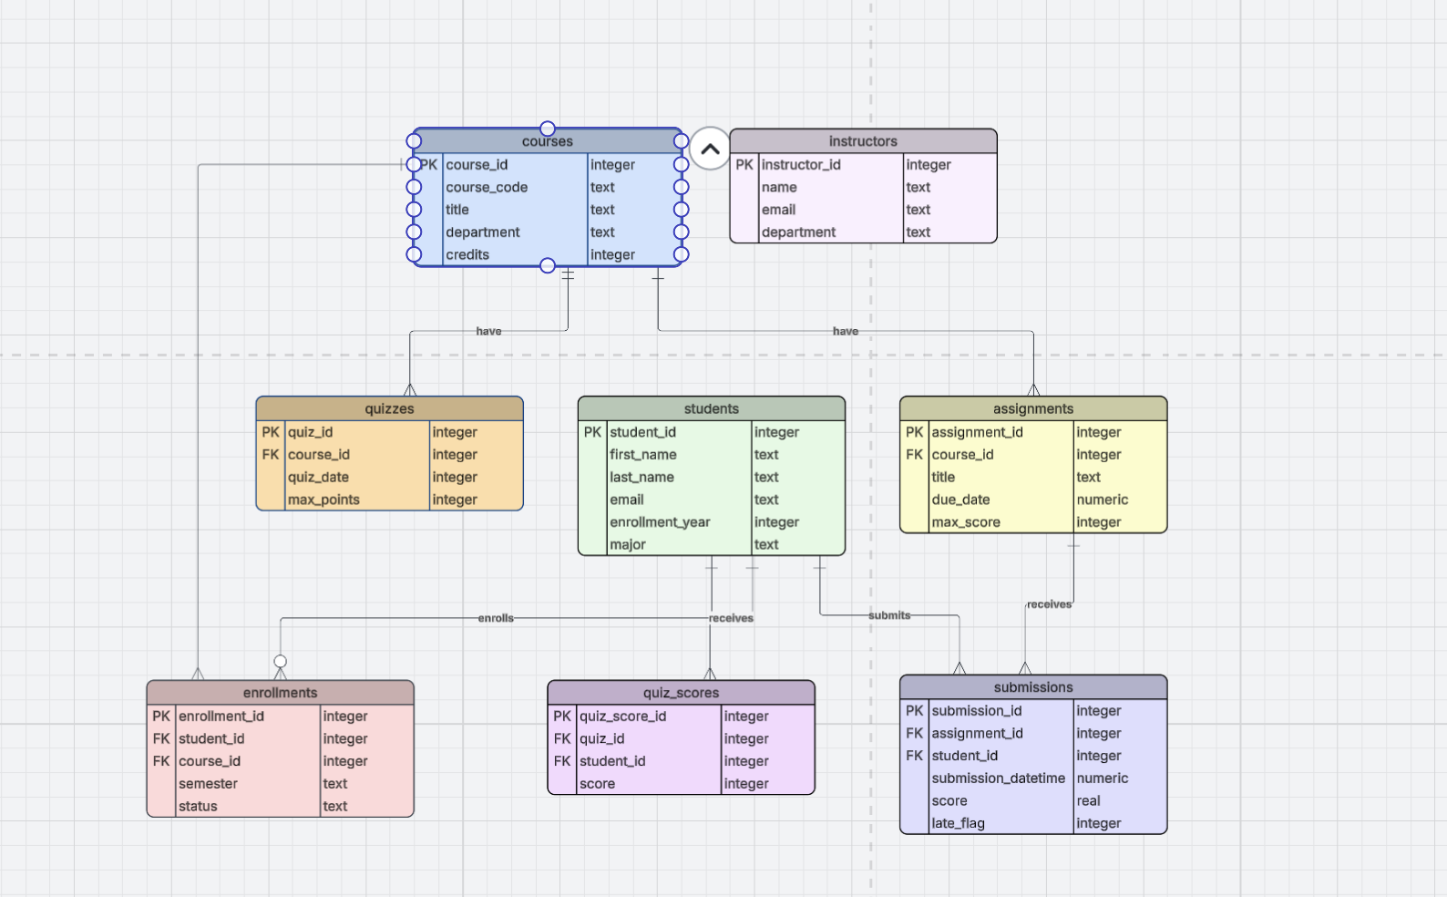
Entity-Relationship Diagram (ERD): lms.db

Slide 5
Key SQL Questions
What are the most active courses?
Most Active Courses
Insight: Courses with higher assessment volume create more frequent engagement points and may require pacing adjustments.
Course | Assignments | Quizzes
CS101 | 12 | 4
BIO201 | 10 | 3
HIST110 | 6 | 1

Slide 6
Assignment Performance Overview
What are the min, max, and average scores for each assignment?
Insight: While most assignments show stable performance, lower averages may indicate difficulty spikes or unclear instructions.
Assignment | Min | Max | Avg
A1 | 40 | 100 | 82
A2 | 55 | 98 | 75
A3 | 20 | 96 | 68

Slide 7
Which students have incomplete or late submissions?
Insight: Repeated late or missing work signals early disengagement and aligns with academic risk indicators.
Student | Late | Missing
S101 | 3 | 1
S204 | 5 | 0
S330 | 2 | 3

Slide 8
Machine Learning Problem & Features
Machine Learning (ML) Problem:
Predict which students may be academically at risk.
Binary classification using performance and engagement data.
Key Features Used:
Assignment averages and score ranges
Quiz averages and number of attempts
Total submissions and late submissions
Number of course enrollments

Slide 9
Model Evaluation Metrics
Metrics Used for Classification:
Accuracy: Overall correctness of predictions
F1 Score: Balance between precision and recall
AUC: Ability to distinguish at-risk vs not-at-risk students
Why These Metrics Matter:
Support early identification of risk patterns
Show tradeoffs between false positives and false negatives
Help evaluate model reliability

Slide 10
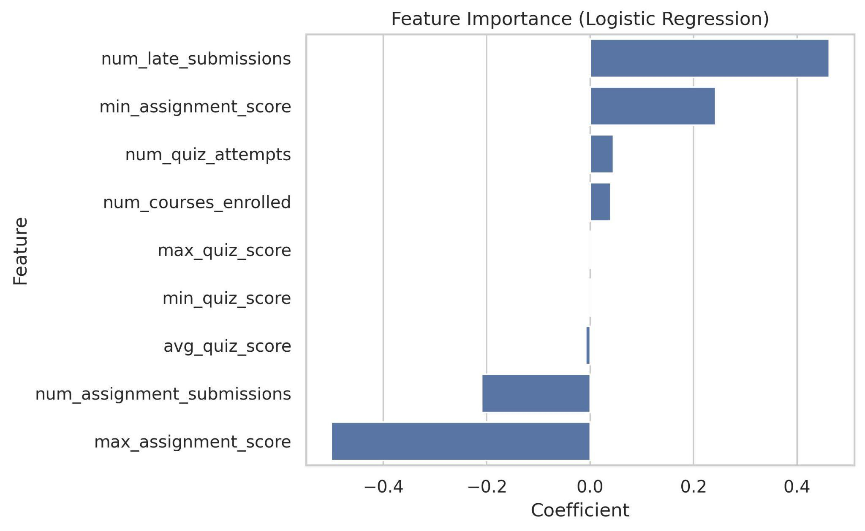
Feature Importance Plot
(Logistic Regression)
Shows which features contribute most to predicting at-risk students.
Highlights top drivers like late submissions, assignment scores, and quiz averages.
Used to understand model transparency and guide interventions.

Slide 11
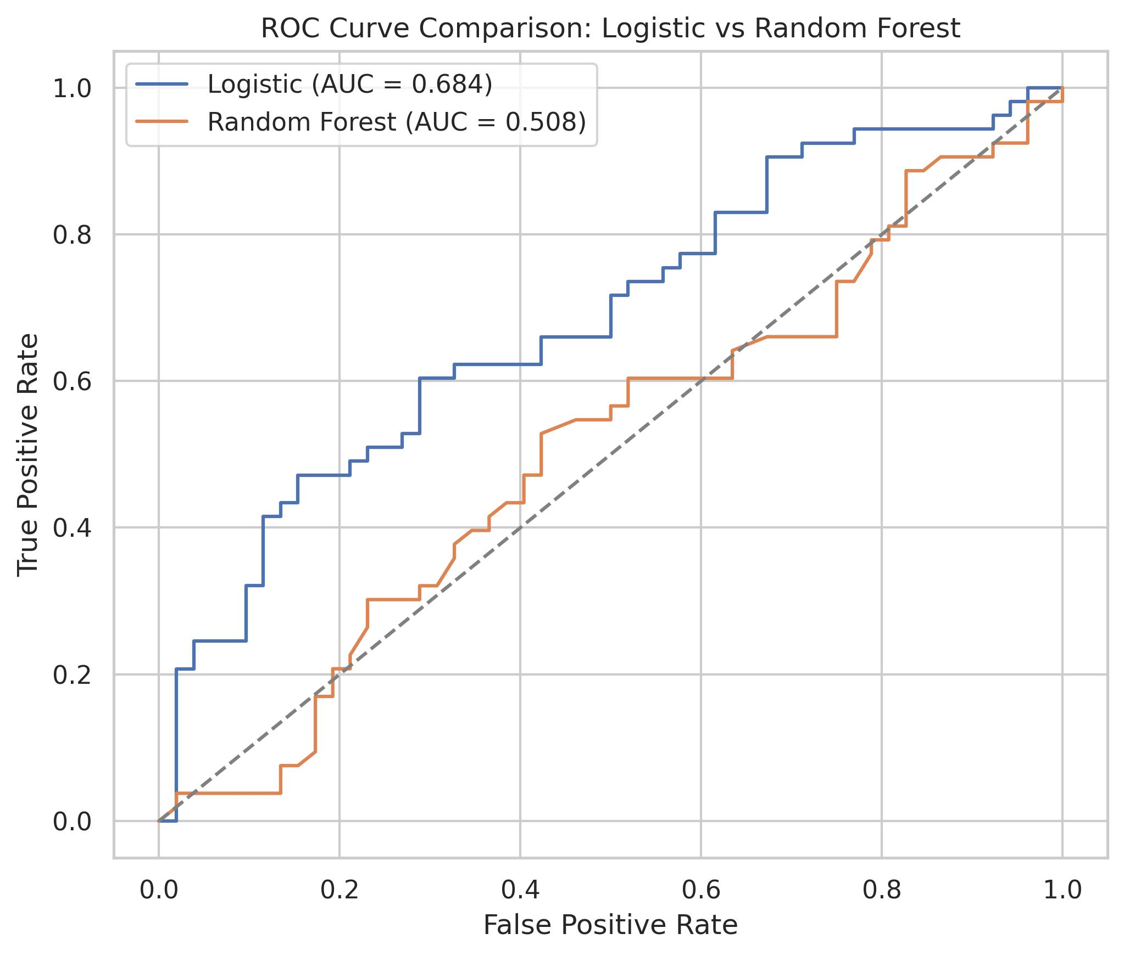
ROC Curve Comparison
Compares ROC curves for Logistic Regression vs Random Forest.
Shows how well each model separates at-risk vs not-at-risk students.
Helps evaluate classification performance across thresholds.

Slide 12
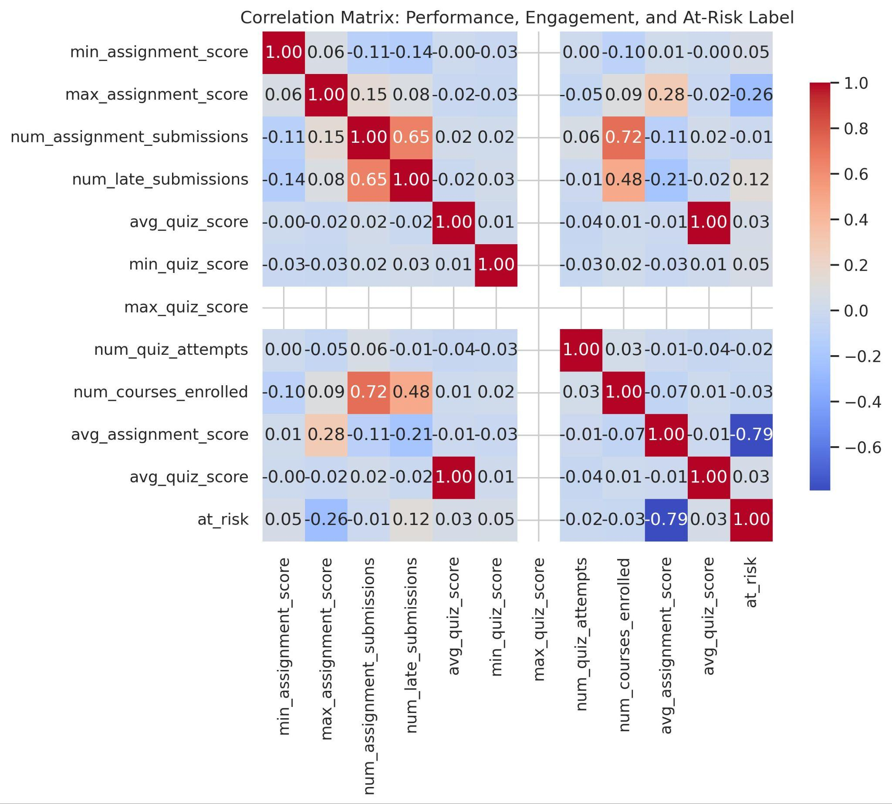
Correlation Heatmap
Shows relationships between performance, engagement, and risk label.
Identifies strong patterns such as assignment average and lateness.
Helps understand feature interactions and dataset structure.

Slide 13
Key Takeaways
SQL and ML together help uncover performance and engagement trends.
Late submissions and quiz/assignment averages strongly predict academic risk.
Visualizations make complex patterns easier to interpret and communicate.
Features engineered through SQL create a strong foundation for modeling.
- Insights support early intervention and data-informed academic decisions.

Slide 14
Limitations
Dataset does not include behavioral, demographic, or LMS activity logs.
At-risk label is defined relative to class averages rather than fixed standards.
There is no connection to instructors in the schema.
Feature set may not capture external factors influencing performance.
Predictive accuracy is constrained by available data quality and scope.

Slide 15

Any questions?
THANK YOU!
ohancock@bu.edu
github.com/olvhnk/AD599-Final-Project

